Slide 1
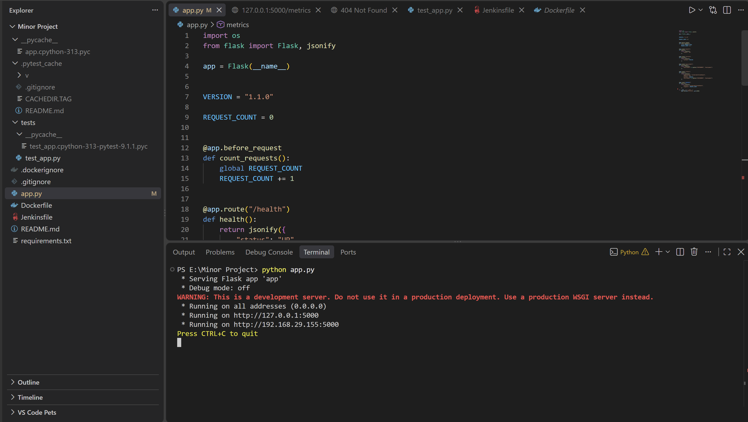
system-health-dashboard
• Flask-based System Health Dashboard API
• Provides health, status, version, environment and metrics endpoints
• Goal: automate build, test and health verification through Jenkins

Slide 2
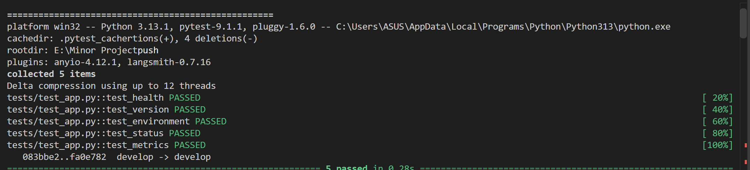
Application Endpoints
-/health
-/version
-/environment
-/status
-/metrics

Slide 3
Automated Testing
Created tests/test_app.py with 5 tests
Each test uses Flask's app.test_client()
Assertions validate HTTP status and JSON responses
Tests run automatically before Docker build

Slide 4
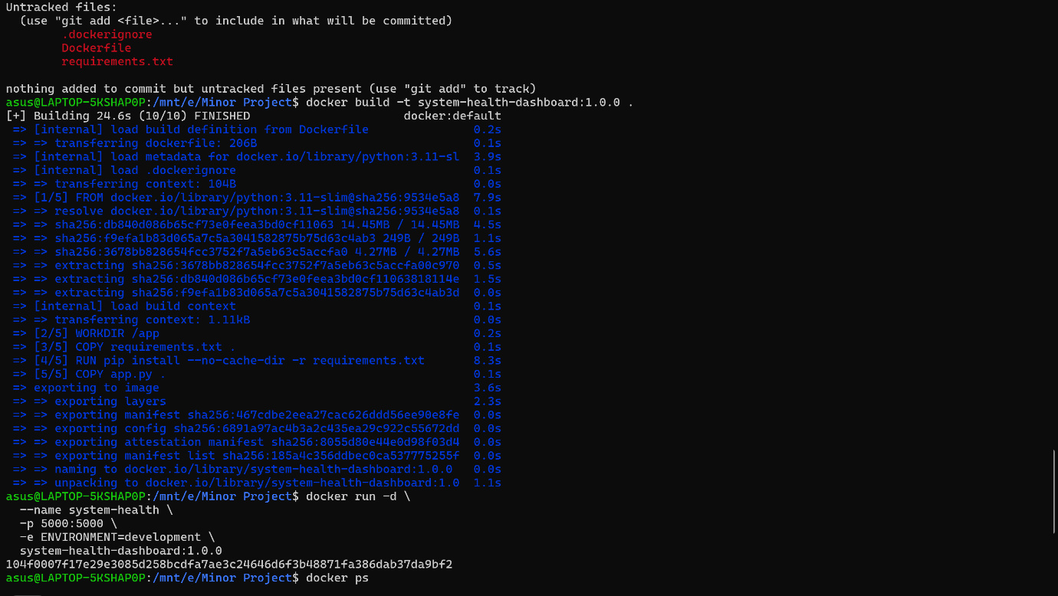
Dockerization
• Dockerfile uses python:3.11-slim
• WORKDIR /app
• Installs dependencies from requirements.txt
• Copies app.py into the image
• Application runs on port 5000

Slide 5
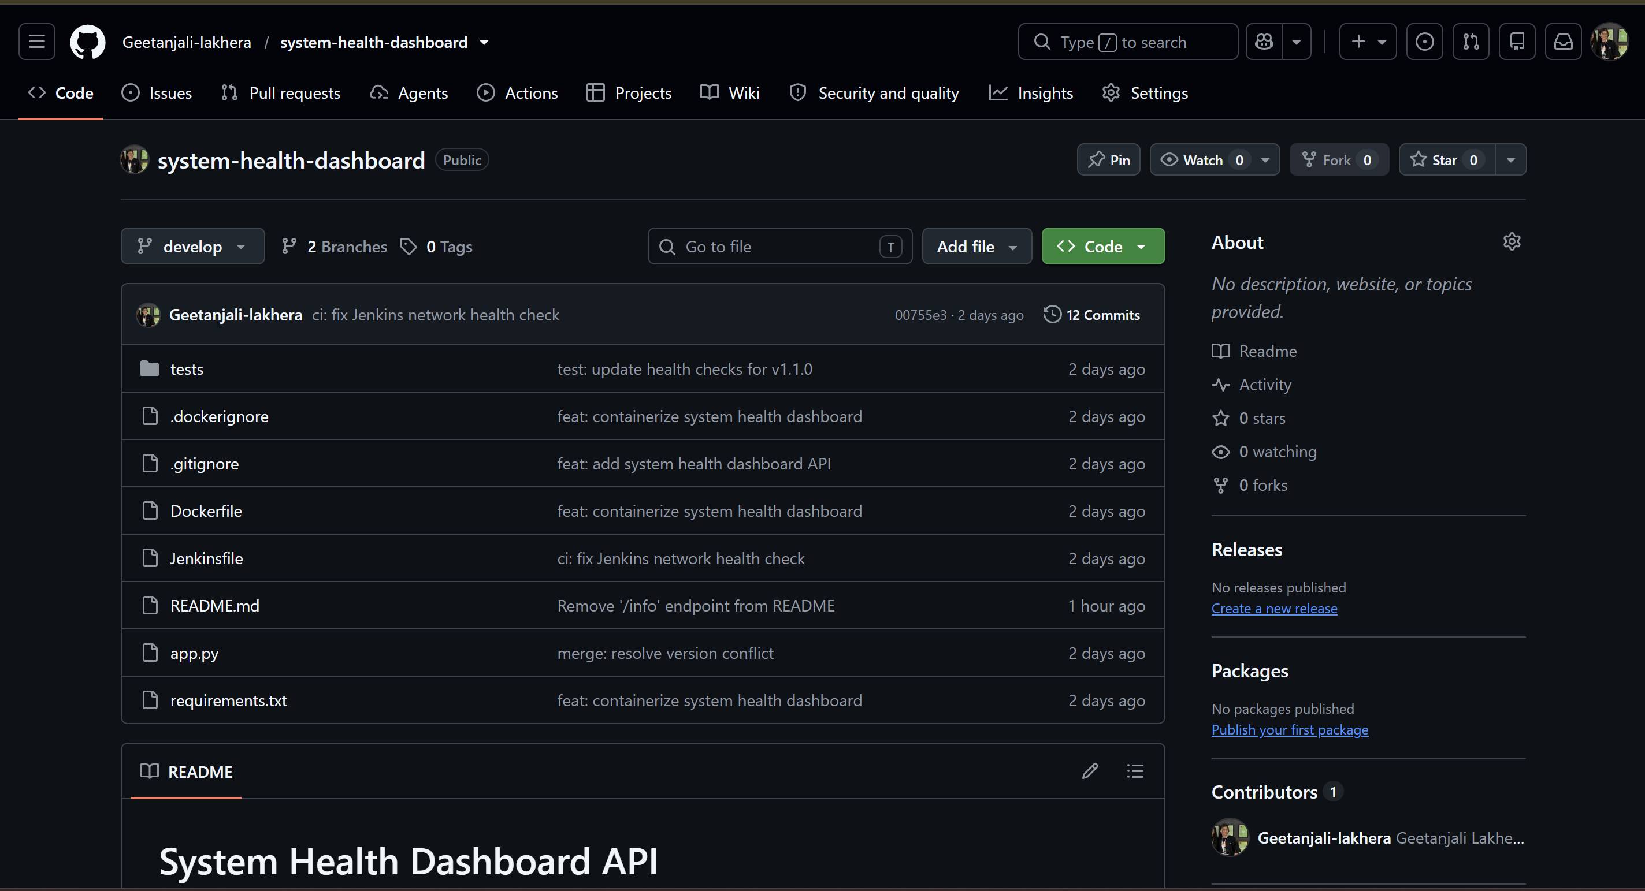
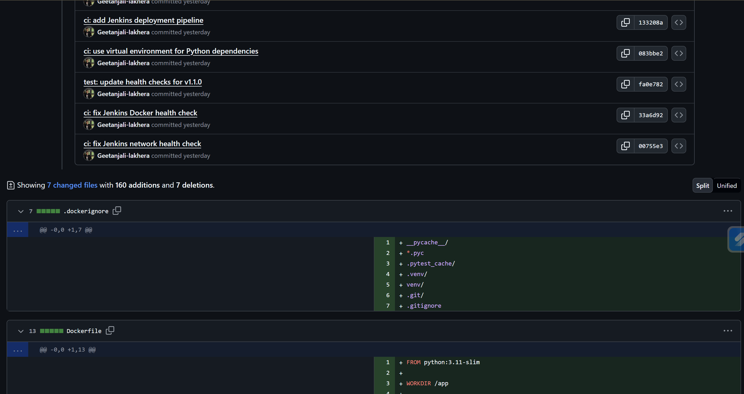
Git & Github workflow
Branches used: main, develop, feature branches.
Feature work was merged/resolved through Git history.
Pull-request history provides review/merge evidence.

Slide 6
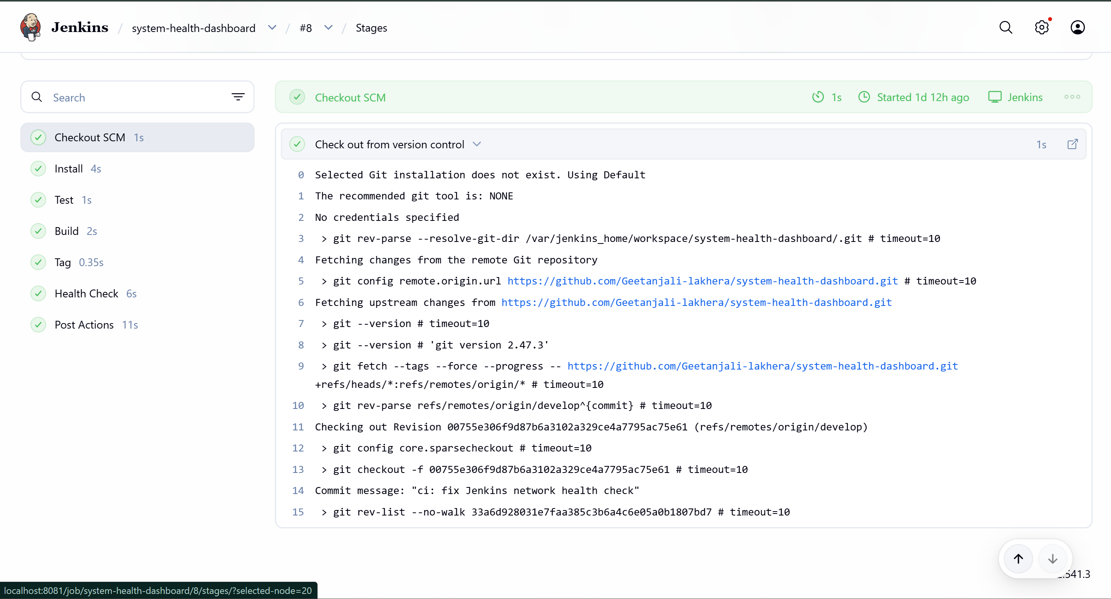
Jenkins CI/CD Pipeline
• Checkout → retrieves develop branch
• Install → creates Python virtual environment + dependencies
• Test → runs pytest
• Build → creates versioned Docker image
• Tag → creates latest tag
• Health Check → runs container and verifies /health
http://localhost:8081

Slide 7
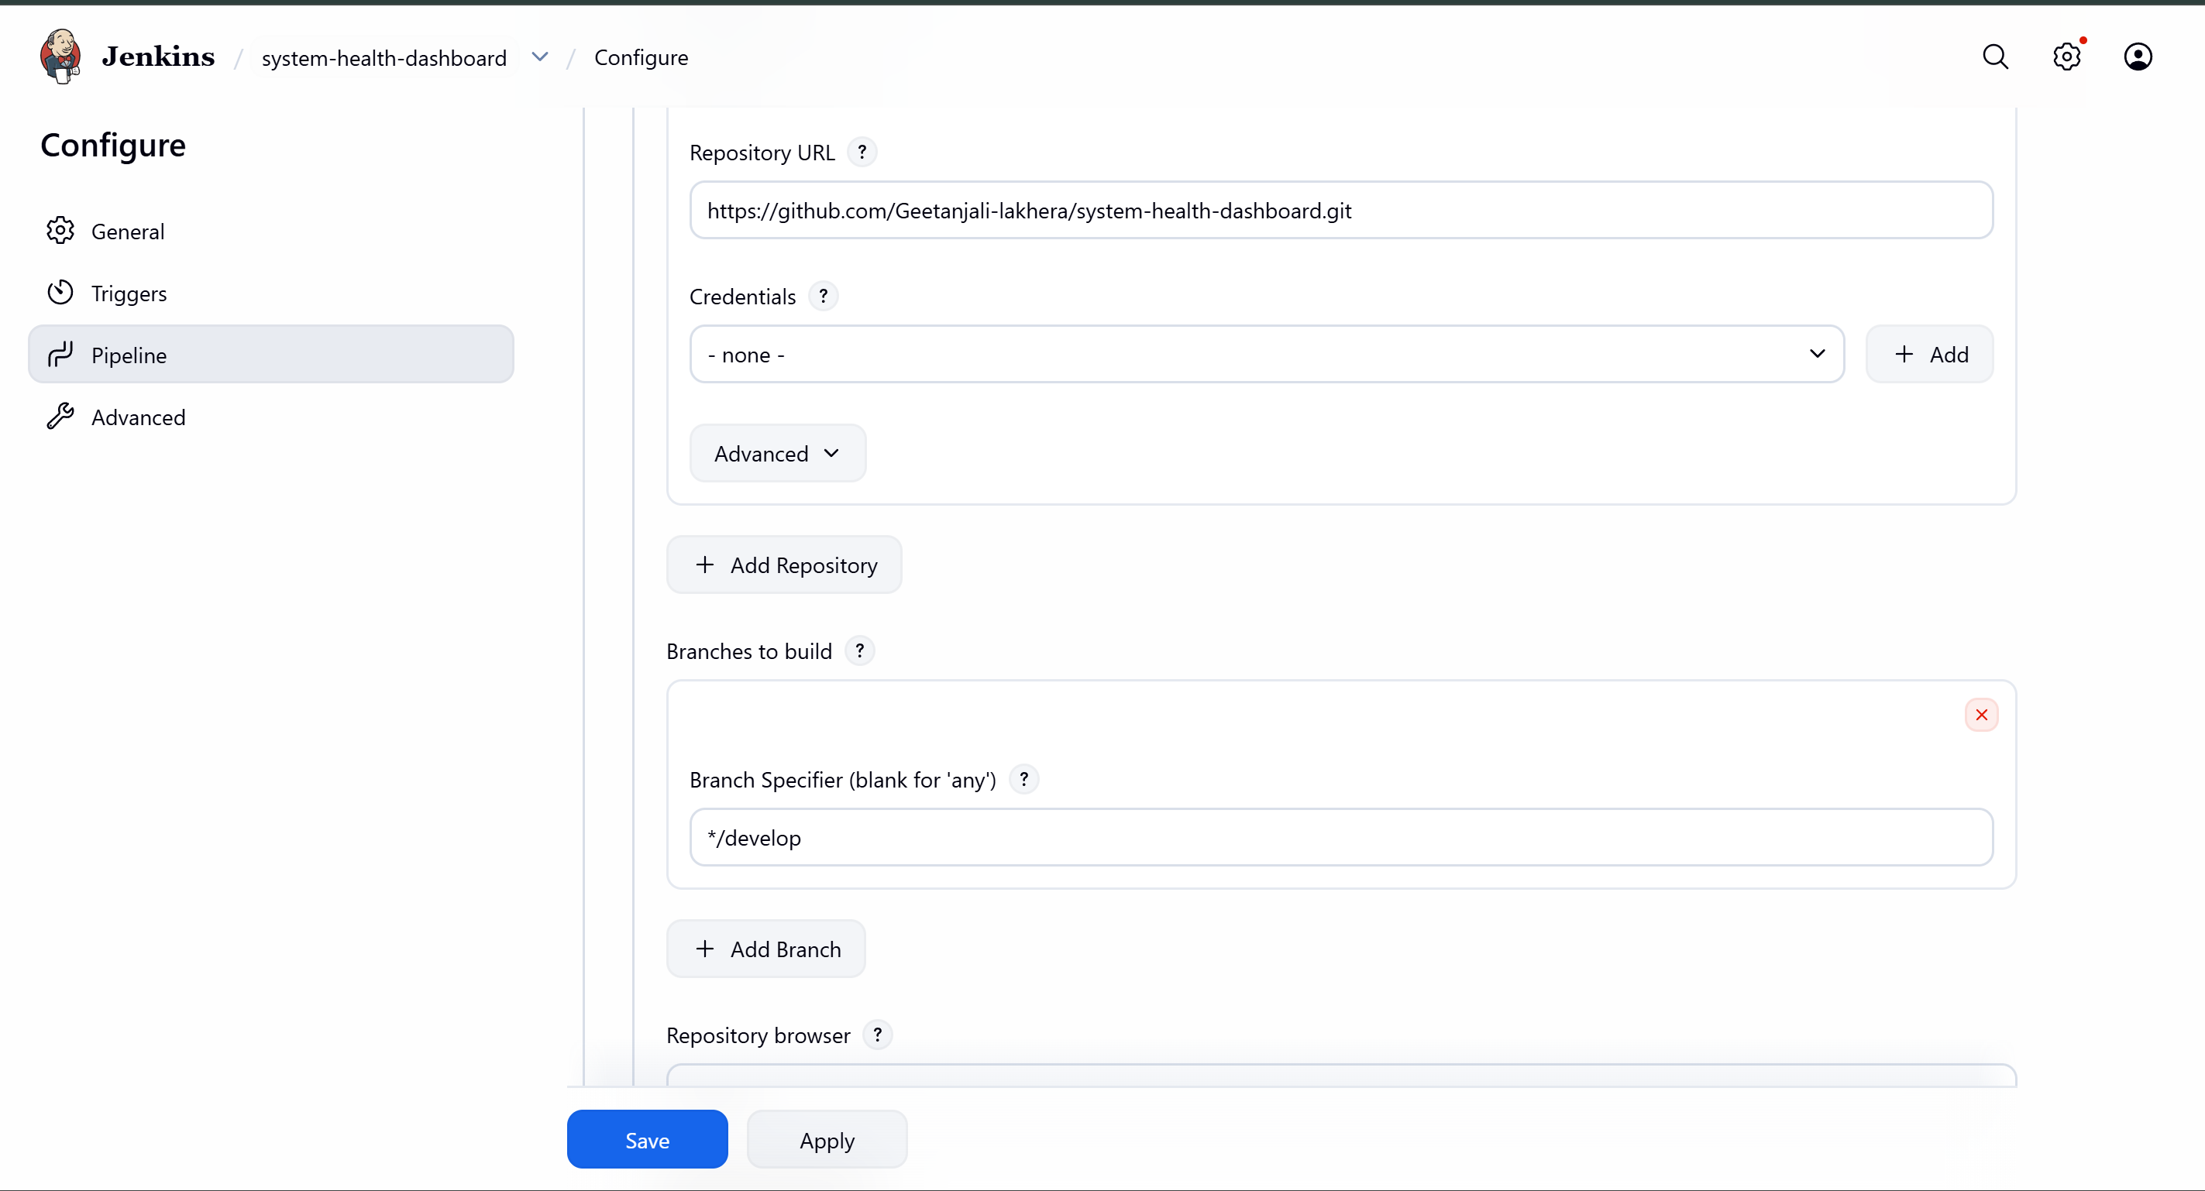
WORKFLOW
• Developer changes code
↓
• Commit & push to GitHub
↓
• Jenkins checks out develop
↓
• Install dependencies → Run tests
↓
• Build & tag Docker image
↓
• Run container on Jenkins network
• Verify /health
• SUCCESS / FAILURE

